Slide 1



Kookaburra Incorporated (#13)
Carpooling Connections
Team:
Jose Escobar
Maxine Hartnett
Samuel Henry
Kushal Joshi
Jiachen Shi
Johnathan Kruse
$

Slide 2

Kookaburra Incorporated (#13)
Solution

Slide 3
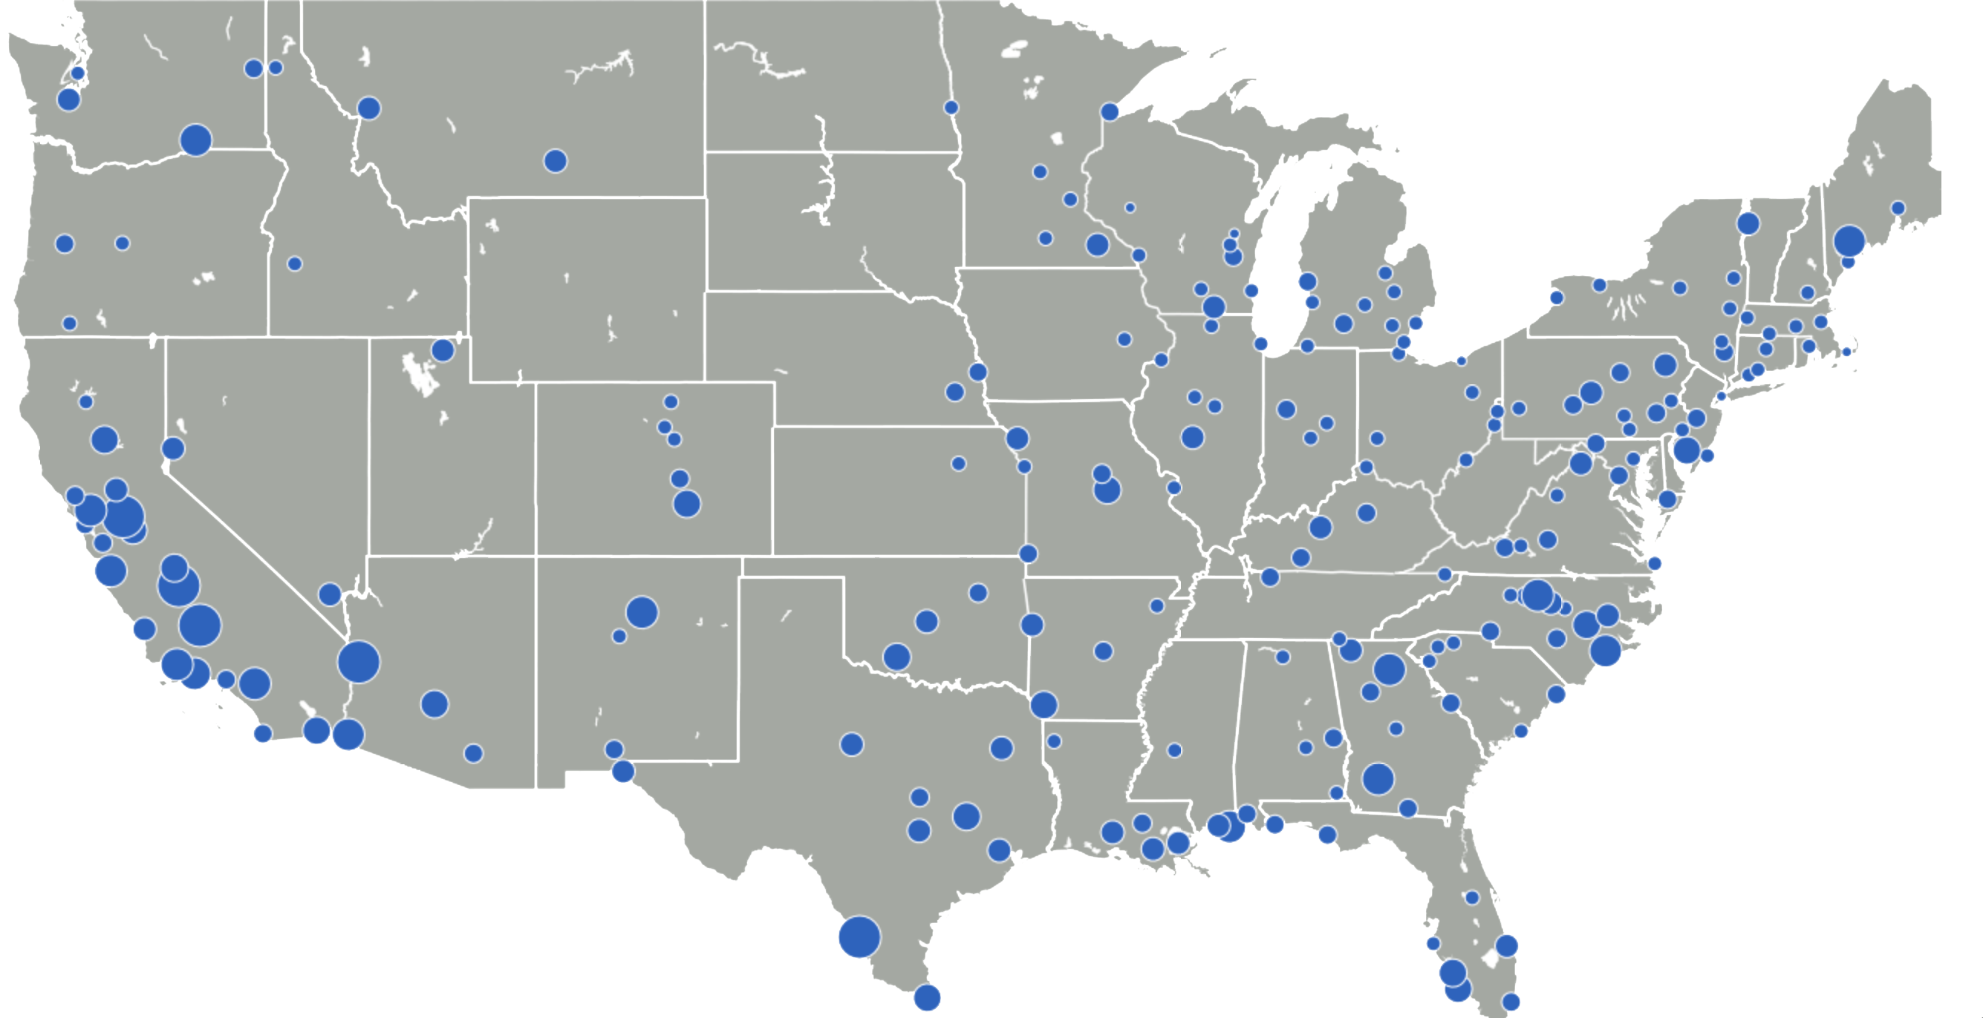
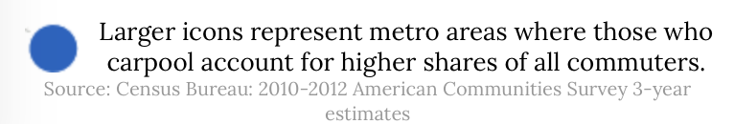
Kookaburra Incorporated (#13)
Market
Notes:
Credit to http://www.governing.com/gov-data/transportation-infrastructure/carpool-commuting-data-metro-area-map.html

Slide 4

Kookaburra Incorporated (#13)
Demo

Slide 5








Kookaburra Incorporated (#13)
Technical Details
Agile
HTML

Slide 6
Kookaburra Incorporated (#13)
Team:
Car with $ and clock (Benefits of CC)
Carpooling Connections

